Slide 1
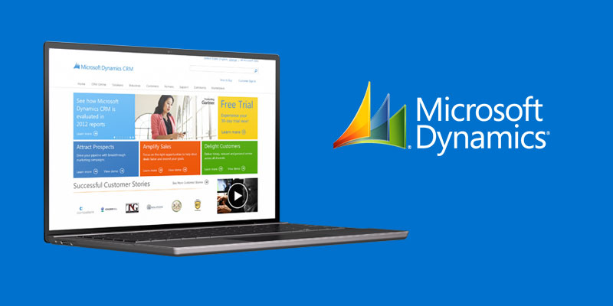
Microsoft Dynamics Website
The Challenge
<p>The Microsoft Dynamics Marketing team wanted to update its website to be consistent with Microsoft&#39;s new branding guidelines.</p>
What We Did
<ul>
<li>Affirma&#39;s Creative Services department worked closely with Microsoft&#39;s brand team to learn about the new style-guidelines. Our team constructed wireframes and built out a colorful design for the public-facing Dynamics website. This was one of the very first public-facing Microsoft sites to adopt the new style-guidelines.</li>
</ul>
Results
<p>Affirma was praised for delivering a user-centered design, consistent with the updated Microsoft branding and style.</p>

